Slide 1
MOBILE PHONE JAMMER
ECE-2002
ANALOG ELECTRONIC CIRCUITS
J-COMPONENT
REVIEW - 1

Slide 2
Group Members:
D. CHARAN
T. JAYANTH KUMAR
M.B.V. SRI HARSHA
K.MADHU SEKHAR

Slide 3
ABSTRACT
A GSM Jammer or cell phone jammer is a device that transmit signal on the same frequency at which the GSM system operates, the jamming success when the mobile phones in the area where the jammer is located are disabled.
Communication jamming devices were first developed and used by military.
Where tactical commanders use RF communications to exercise control of their forces, an enemy has interest in those communications. This interest comes from the fundamental area of denying the successful transport of the information from the sender to the receiver.
Nowadays the mobile jammer devices or cell phone jammer software are becoming civilian products rather than electronic warfare devices, since with the increasing number of the mobile phone users the need to disable mobile phones in specific places where the ringing of cell phone would be disruptive has increased. These places include worship places, university lecture rooms, libraries, concert halls, meeting rooms, and other places where silence is appreciated

Slide 4
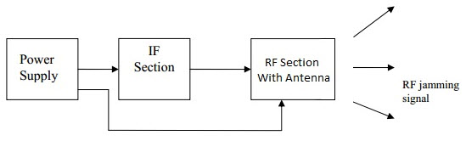
Block Diagram Of Mobile Jammer:

Slide 5
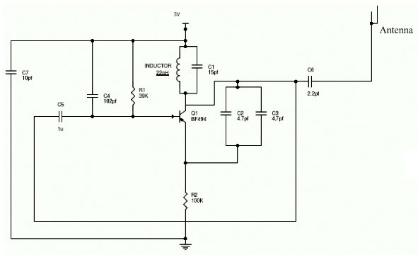
CIRCUIT DIAGRAM

Slide 6
Components Required:
Resistors
Capacitors
Inductor
Transistor
3V Power supply
Connecting wires

Slide 7
APPLICATIONS
The Mobile jammers are used in the classrooms, and library to maintain silence
It is used in the seminar halls and meeting rooms to avoid disturbances
It is used in the hospitals
The mobile jammers are used in the temples, churches, etc.

